Slide 1

Zeronize website

Slide 2
"Revolutionizing Engines, One Mile at a Time."
zeronize

Slide 3
Problem worth solving
Vehicle owners and fleet managers face a critical challenge: limited engine lifespan. This results in costly repairs, premature replacements, and significant downtime. The industry urgently needs a solution to extend engine life, slash maintenance costs, and maximize operational efficiency.
zeronize

Slide 4
Our solution
Zeronize's revolutionary PowerCoding™ process combats engine wear, extending lifespan for all car types and engines. Our universal solution enhances performance, regardless of liner surface structure, ensuring your engine runs for over 1 million kilometers (600,000 miles).
zeronize

Slide 5
Target market
Los Angeles new zeronize center
Dallas, TX new zeronize center
Atlanta, GA new zeronize center
Chicago, Il new zeronize center
Miami, FL new zeronize center
zeronize

Slide 6
Competitive landscape
Competitors | How our solution is better
Jiffy lube | We focus on engine longevity & economy
Firestone | Focus on improving engine performance
Midas | Focus on improving engine performance
zeronize

Slide 7
Funding needed
$15M
To fund our Start-up and start acquiring suitable land sites and building out with zeronize centers
zeronize

Slide 8
Sales channels
Zeronize educates customers on PowerCoding™'s revolutionary benefits through targeted outreach. We offer diverse payment options, including credit cards, bank transfers, and custom financing, to ensure seamless transactions and maximize accessibility for all potential clients.
zeronize

Slide 9
Marketing activities
Target markets: vehicle owners, high-mileage drivers, luxury car enthusiasts, fleet operators. Focus: US cities. Strategies: digital marketing, partnerships with auto shops, trade shows, influencer collaborations. Highlight eco-friendly benefits and cost savings of PowerCoding™ process.
zeronize

Slide 10
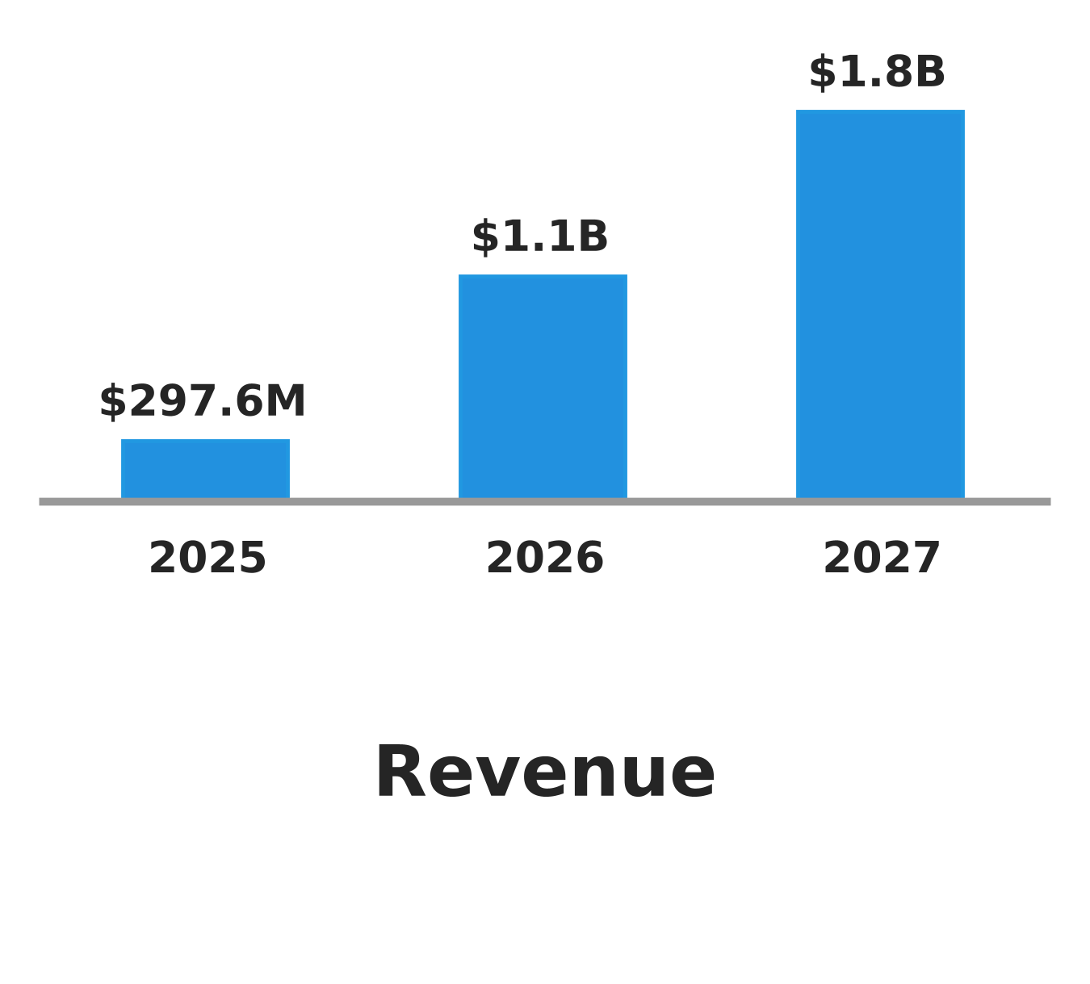
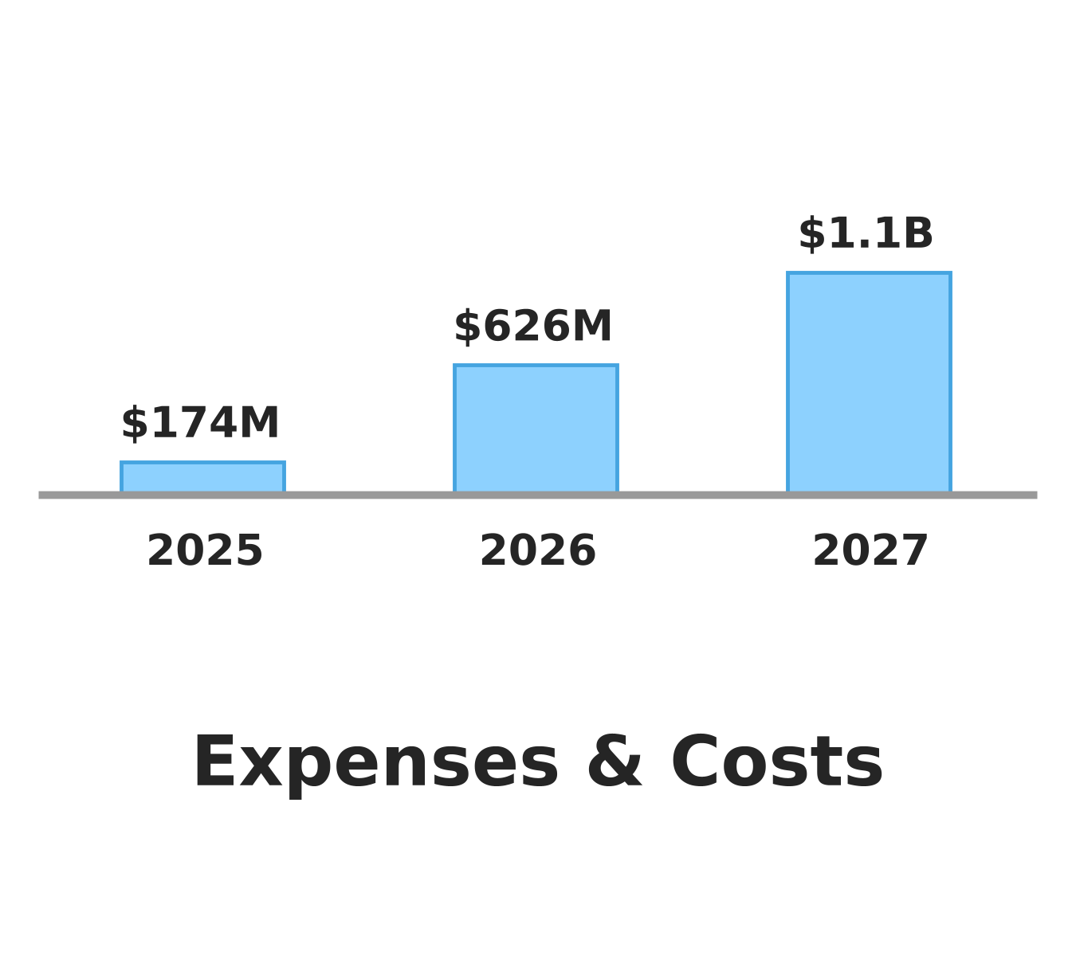
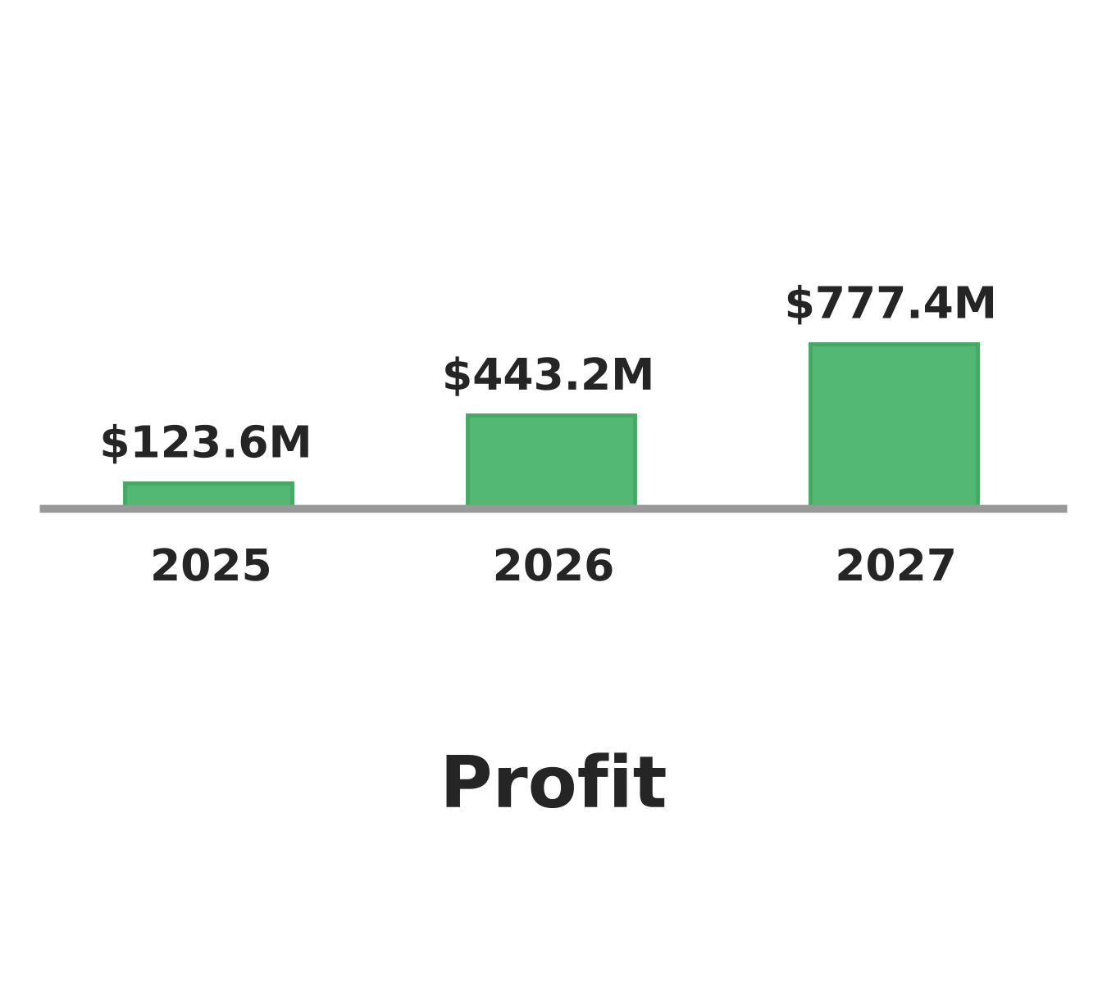
Financial Projections
zeronize

Slide 11

Milestones
Due Date | Milestone
January 1, 2025 | Find Venture Capital zeronize 15 Million
January 6, 2025 | Identify a regional /national realtor to locate sites
January 28, 2025 | Complete design & Plans for zeronize center
January 30, 2025 | Land Acquisition LA
March 1, 2025 | Start construction of LA zeronize center
zeronize

Slide 12






Team and Key Roles
Ingo Storm
Martin Wolons
Jack Storm
CEO/Founder
CFO
IT Specialist
Peter Muller
Rahatul Asef
Stephen Yas
Specialist Engineer
HR Director
Architect AIA,RIBA,NCARB
zeronize

Slide 13



Partners and Resources
Mobil Oil
Exxon
Gulf
zeronize

